Slide 1
CGC & The Green Bank Financing Model to Accelerate Clean Energy Market Growth
Coalition for Green Capital
April 2017

Slide 2
Green Bank financing can drive private investment, business growth, energy savings, CO2 reductions
Public dollars are limited. Must be used wisely and efficiently to maximize impact
Green Bank financing designed to animate private capital, get bang for the buck
Deploys cost-saving clean energy – renewables & efficiency – lower consumer and business energy bills
With financing, public dollars are recycled and re-used
Now, more than ever, market-oriented and private-sector focused climate and energy solutions are needed
Green Banks have already mobilized over
$20 billion of clean energy investment globally

Slide 3
CGC is the leading expert on Green Bank model & institution formation
Thought Leadership
Advocacy
Consulting
CGC, a non-profit, partners directly with governments and NGOs to study, design and implement Green Banks
Helped design & create 6 GBs, which have catalyzed nearly $2 billion in clean energy investment
CEO Reed Hundt, former chairman of U.S. FCC
Supported by major global foundations

Slide 4
CGC is expanding Green Bank footprint around the world with support of leading foundations
Green Banks created by CGC have sparked $2B investment
CGC a driving force behind expanding Green Bank interest
Working in 15 states to create state Green Banks
Partnering with Congressional leaders to create National GB
Ramping up Int’l work to explore Green Bank opportunity in developing nations to meet Paris climate promises
Funding from largest environmental foundations, including Hewlett, ClimateWorks, Energy Foundation & RBF
Partner with government leaders and NGOs
Engage with Obama WH, DOE, USDA, CEQ, EPA & state energy offices
Work with NRDC, NASEO, ACEEE, OECD & IADB

Slide 5
Table of Contents
Green Bank Introduction
Green Bank Landscape & Outcomes
Green Bank Creation & Design
Global Green Bank Trends & Lessons Learned
CGC’s Green Bank Projects & Ways We Can Help

Slide 6
Green Banks fill financing gaps & stimulate demand to make clean energy markets grow
A Green Bank is a dedicated financing entity that drives private investment with limited public resources to accelerate the growth of clean energy markets
Deploy public-purpose capital efficiently to maximize total investment
Green Bank
Implement new market behavior and lower price to spark demand
Inefficient Capital Markets
Clean Energy Market
Tepid Consumer Demand

Slide 7
Why Green Banks? Because of importance of dedicated local institutions
Specific Focus
Prime the Pump
Take 1st or 2nd Loss
Carry Market-Making Costs
Convene & Organize
Local Capital Formation

Slide 8
Green Banks follow common principles, tailored to fit market needs & policy objectives
Green Bank Guiding Principles of Operation
Utilizes public-purpose dollars to leverage private capital
Provides financing to underserved market sectors
Is market-oriented, and aims to increase consumer protection, information transparency, and ease of adoption
Is steadfast in the face of changing political landscape, budget changes, and administrative priorities
Is a flexible and adaptable institution that reacts to market

Slide 9
Green Banks utilize a common set of techniques and finance tools to address targeted market barriers
Multiple
Finance Tools
Market Development
Innovative
Mechanisms
Loans
Credit Enhancement
Warehousing & Securitization
Contractor Training
Info Transparency
Standardization
Demand Aggregation
PACE/Local Improvement Charges
On-Bill Recovery
ESAs
Efficient & Rapid Market Growth

Slide 10
Green Bank can proactively design and offer holistic products and programs, or respond to market needs

Slide 11
Financing structured so that end customer repayment plus remaining energy bill is less than prior energy bill
BEFORE
AFTER
Utility Bill
Savings
Renewable/ Efficiency Financing Payment
Utility Bill
Grid Electricity
Clean Energy Upgrade

Slide 12
Green Bank approach delivers unique benefits vs. other policy approaches
Green Bank Benefits
Private Sector Leverage
Financial tools designed to maximize the amount of private sector investment per public dollar used
Efficient Government
Provide loans to preserve public capital & do deeper efficiency projects
Work in coordination with other agencies to maximize program value
Create Jobs & Economic Growth
Clean energy financing enables demand for projects from contractors
Public private partnerships create investment opportunities for lenders
Put Money Back in Citizens’ Pockets
Less funding needed to support public financing than public grants
Reduced energy bills with efficiency, renewables create monthly savings

Slide 13
Table of Contents
Green Bank Introduction
Green Bank Landscape & Outcomes
Green Bank Creation & Design
Global Green Bank Trends & Lessons Learned
CGC’s Green Bank Projects & Ways We Can Help

Slide 14
Operating Green Banks have already driven USD $22B investment, proven the model works
USD 6.3 billion in capital committed or invested
UK Green Investment Bank
CT Green Bank
Japan Green Finance Organization
NY Green Bank
USD 22 billion total capital mobilized for clean energy projects
GreenTech Malaysia
Clean Energy Finance Corporation
Leverage ratios 3x, 4x…11x for certain investments
Source: NRDC and CGC calculation
14

Slide 15
6 Green Banks of the Green Bank Network have financed projects across renewables and efficiency
Energy Efficiency
Commercial retrofits
Energy management systems
LED street lighting
Low emissions vehicles
Residential retrofits
Onshore Renewables
Geothermal
Onshore wind
Small hydro
Solar PV and thermal
Storage
Wind
Offshore Renewables
Offshore wind
Wave energy
Waste and Bioenergy
Anaerobic biogas
Biomass
CHP
Landfill gas
Waste to energy
Percent of total GBN members’ capital investments and commitments by sector
Notes & Sources: Preliminary estimate by NRDC and CGC based on available data
15

Slide 16
Case Study: Longest-running Green Bank in CT shows that the model works
CT Grows Residential Solar With More Financing While Reducing Subsidies
Green Bank Launched
Source: Energize CT, Residential Solar Investment Program, “Section 106 Data – Information on Installers and Costs – Updated April 1, 2016,” available at http://www.energizect.com/your-home/solutions-list/residential-solar-investment-program.

Slide 17
Table of Contents
Green Bank Introduction
Green Bank Landscape & Outcomes
Green Bank Creation & Design
Global Green Bank Trends & Lessons Learned
CGC’s Green Bank Projects & Ways We Can Help

Slide 18
Three common forms of GBs, with varying degrees of reliance on government for creation, capital, power
Public
Directly part of government
Quasi-Public
New or repurpose wholly-owned instrumentality
“Government Adjacent” Private Non-Profit
Corporation is completely independent of govt
Either an independent agency, or division of existing
Typically has Board mix of govt and non-govt Directors
Ideally still connected to government in some way…

Slide 19
Successful examples of operating GBs in all forms
Public
Quasi-Public
Private
Non-Profit

Slide 20
Long-list of potential U.S. Green Bank capital sources – must be low-cost and patient (i.e. public purpose)
Federal Government
Grants from DOE
Grants from Treasury via CDFI
Loans from Treasury via CDFI
Capital from EPA via SWRLF
Loans or Loan Guarantee from DOE via LPO
Loans from USDA via RUS
Grants from USDA via RUS
Loans from DOT
Grants from DOT
State Government
Ratepayer Dollars
Budget Dollars
Remaining ARRA Funds
Repurpose Existing Funds
Bond Structures
QECBs
CREBs
Private Activity Bonds
Non-profit Conduit Bonds
Industrial Revenue Bonds
Asset-backed Securities
GO Bonds of State/Local government
Foundations
Grants
PRI
Private
High Net Worth Individuals
Money Center Banks & Other CRA Investors
Mission-Driven

Slide 21
And National GBs abroad can use range of capital sources for locally-determined investment needs
Environmental Funds
(e.g. GCF)
Foreign Institutional Investors
(e.g. Pensions)
Developing Nation
Development Finance Institutions
(e.g IDB)
Green Bonds
$
$
$
$
National Govt
$
National Green Bank
Local Domestic Lender
$
Clean Energy Projects

Slide 22
Growing set of proven products and solutions to address range of potential target markets in the U.S.
Target Market | Barriers | Products
Residential Efficiency | Long payback period Trust in savings Loan security Small projects | WHEEL Standard-Offer LLR (CT & MI) R-PACE
LMI SFH Solar | Cost of solar power FICO requirements | Solar Lease + EE Upgrade (CT)
LMI Solar Rental | Split incentives | Community Solar (CO)
Commercial Efficiency | Low capital priority Long payback period Difficulty underwriting | C-PACE Direct Lending (for small projects)
Municipal Efficiency | Procurement rules Low capital priority Debt limits | Bundled ESCO Bond (DE) Muni Bond Aggregation (RI)
Innovative Grid-Tied Renewables | Perceived risk Lack of liquidity | Market-Responsive RFP Fund (NY)

Slide 23
Table of Contents
Green Bank Introduction
Green Bank Landscape & Outcomes
Green Bank Creation & Design
Global Green Bank Trends & Lessons Learned
CGC’s Green Bank Projects & Ways We Can Help

Slide 24
In the U.S., the Green Bank model is successful and growing
Since 2011, six state and local Green Banks have been established.
As of mid FY17, Green Banks have sparked ~$2 billion in energy investment, with majority of dollars coming from private sector
Notes & Sources: CGC analysis; Green Bank numbers for fiscal year

Slide 25
Large increase in interest from Foundation & Private sector to offer public-purpose dollars for this cause
Federal Government
Grants from DOE
Grants from Treasury via CDFI
Loans from Treasury via CDFI
Capital from EPA via SWRLF
Loans or Loan Guarantee from DOE via LPO
Loans from USDA via RUS
Grants from USDA via RUS
Loans from DOT
Grants from DOT
State Government
Ratepayer Dollars
Budget Dollars
Remaining ARRA Funds
Repurpose Existing Funds
Bond Structures
QECBs
CREBs
Private Activity Bonds
Non-profit Conduit Bonds
Industrial Revenue Bonds
Asset-backed Securities
GO Bonds of State/Local government
Foundations
Grants
PRI
Private
High Net Worth Individuals
Money Center Banks & Other CRA Investors
Mission-Driven

Slide 26
New Green Banks are being explored from largest market (India) to smallest (DC)
Operating GBs
In Development or Under Consideration
UK GIB
Australia CEFC
India (National)
Ontario, Canada
Washington, DC
Maryland
Nevada
Colorado
Missouri
Pennsylvania
Vermont
National
Japan GFO
Malaysia GTFS
NY Green Bank
CT Green Bank
RI Infrastructure Bank
CA CLEEN Center
State/Local
HI Green Infrastructure Authority
Montgomery County, MD GB

Slide 27
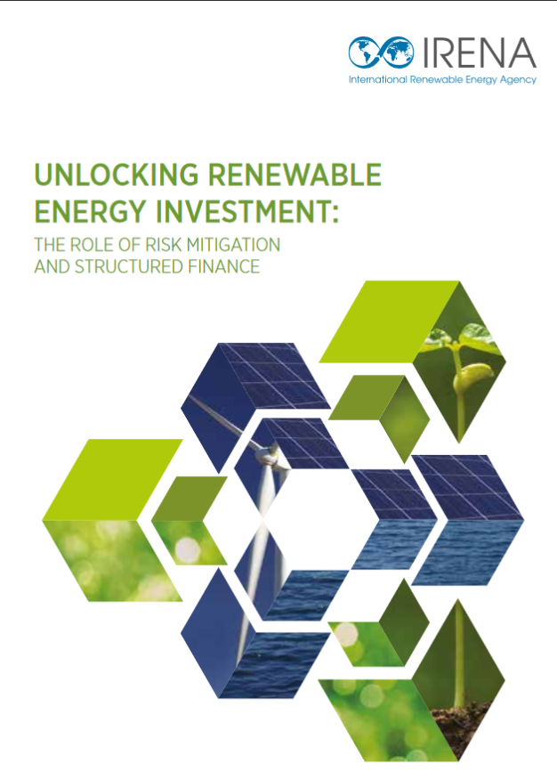
Increasing recognition of Green Bank model by global institutions and experts
OECD Report on Green Banks released at Clean Energy Ministerial (CEM) event May 31, 2016
Felipe Calderon of Global Commission on the Economy and Climate includes Green Bank model in four-point climate plan in Financial Times June 28, 2016

Slide 28
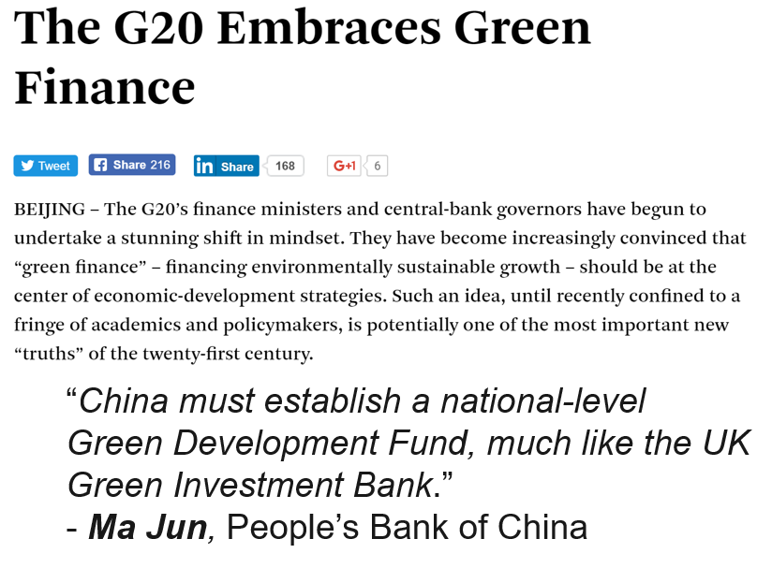
And now Green Bank interest is growing, including in emerging markets

Slide 29
The New Green Bank Network, launched at COP21, is a new hub for Green Bank know-how
International network to connect Green Banks and share best practices
Central hub for know-how
Regular reports on transactions and other news
www.greenbanknetwork.org
Founding Members
Managing Partners

Slide 30
Table of Contents
Green Bank Introduction
Green Bank Landscape & Outcomes
Green Bank Creation & Design
Global Green Bank Trends & Lessons Learned
CGC’s Green Bank Projects & Ways We Can Help

Slide 31
CGC supports governments in multiple ways to conceive of concept, design institution & implement
Connecticut Green Bank – Concept Development & Implementation
CGC worked with government to develop concept, gain buy-in, draft legislation
Serve on Board, design products, provide strategic guidance, share best practices
New York Green Bank – Business Plan Development
Drafted NYGB Business Plan after Governor announced plan to create Green Bank
Built financial model and made business case to regulator to fund the Green Bank
Washington, D.C. – Green Bank Viability Report
Completed formal study for D.C. government to explore need for Green Bank
Identify finance opportunities and appropriate model, to be implemented this fall
Nevada – Legislatively Directed Green Bank Assessment
Policymakers looking for non-partisan solutions to lower energy cost, grow economy
Completed study of opportunity and outlined implementation plan

Slide 32
In the U.S., state & local Green Banks are spreading, with growing interest from all regions
CGC Now Working on Green Banks in 15 states
CA
HI
NY
MA
PA
CO
MD
RI
CT
MO
VT
DE
DC
NV
VA

Slide 33
CGC works with state, federal and international stakeholders through multiple stages GB creation
Complete Study to Determine Green Bank Objective, Products, Structure
Develop Green Bank Implementation Plan
Stand-Up & Operationalize Green Bank
See Resource Center on CGC Website for Past Green Bank Studies

Slide 34
Thank You
Reed Hundt, Chief Executive Officer
rehunt@gmail.com
Jeffrey Schub, Executive Director
jeff@coalitionforgreencapital.com
Twitter: @CGreenCapital

